Slide 1
Simple Sales Data Visualization
NAME:-OM PRKASH KANNAUJIYA
ROLL NO:- 202401100300165
BRANCH:- CSE(AI)
INTRODUCTION:-
The main goal of this code is to analyze and visualize total revenue for different products using sales data. It processes the data, groups it by product category, and creates a bar chart to provide a clear visual representation of revenue distribution.

Slide 2
Methodology of the Code The methodology follows a structured approach to process and visualize sales data efficiently: 1. Data Collection The sales data is manually defined as a multi-line string containing three columns: Product: Name of the item (e.g., Phone, Laptop, Tablet, etc.). Quantity: Number of units sold. Revenue: Total revenue generated from sales. 2. Data Preprocessing The raw string data is read into a Pandas DataFrame using pd.read_csv() with StringIO() delim_whitespace=True ensures that multiple spaces act as column separators.

Slide 3
3. Data Aggregation
The data is grouped by Product using df.groupby('Product')['Revenue'].sum().
This sums up the revenue for each product category to get the total revenue per product.
4. Data Visualization
A bar chart is created using matplotlib.pyplot:
X-axis: Different product categories.
Y-axis: Total revenue per product.
Color styling, labels, and legends are added for better readability.
5. Output and Interpretation
plt.show() is used to display the bar chart.
The visualization helps in understanding which products generate the most revenue, aiding business decisions.

Slide 4
CODE:-
import pandas as pd
import matplotlib.pyplot as plt
from io import StringIO
# Define sales data as a string
# This data contains Product names, Quantity Sold, and Revenue
data = """Product Quantity Revenue
Phone 26 43188
Phone 85 32755
Laptop 11 5579
Monitor 61 28188
Monitor 64 15223
Laptop 18 15893
Phone 92 34084
Tablet 84 32583
Monitor 57 40668
Phone 74 39400
Laptop 79 23234
Phone 12 17356
Monitor 51 34242
Monitor 73 7582
Monitor 72 39434
Tablet 69 32656
Phone 38 44135
Tablet 44 28193
Laptop 86 12652
Tablet 69 31307"""

Slide 5
# Read data into a Pandas DataFrame
df = pd.read_csv(StringIO(data), delim_whitespace=True)
# Aggregate revenue per product
# This groups the data by 'Product' and sums up the 'Revenue' for each product
revenue_per_product = df.groupby('Product')['Revenue'].sum()
# Create a bar chart to visualize total revenue per product
plt.figure(figsize=(8, 5)) # Set figure size
plt.bar(revenue_per_product.index, revenue_per_product.values, color='blue', label='Total Revenue')
plt.xlabel('Product') # Label for x-axis
plt.ylabel('Total Revenue ($)') # Label for y-axis
plt.title('Total Revenue by Product') # Chart title
plt.legend() # Add legend to indicate what the bars represent
plt.show() # Display the chart

Slide 6
Import Libraries:
Uses pandas for data handling and matplotlib.pyplot for visualization.
StringIO is used to treat the sales data as a file-like object.
Define Sales Data:
A multiline string stores product sales data with columns: Product, Quantity, and Revenue.
Load Data into Pandas DataFrame:
pd.read_csv(StringIO(data), delim_whitespace=True) reads the string as a table.
Calculate Total Revenue per Product:
df.groupby('Product')['Revenue'].sum() sums up revenue for each product type.
Create a Bar Chart:
The bar chart displays total revenue for each product category.
Labels and a legend are added for clarity.
Show the Chart:
plt.show() displays the final visualization.

Slide 7
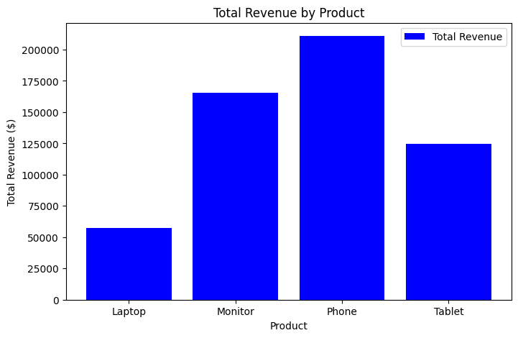
OUTPUT:-

